Slide 1
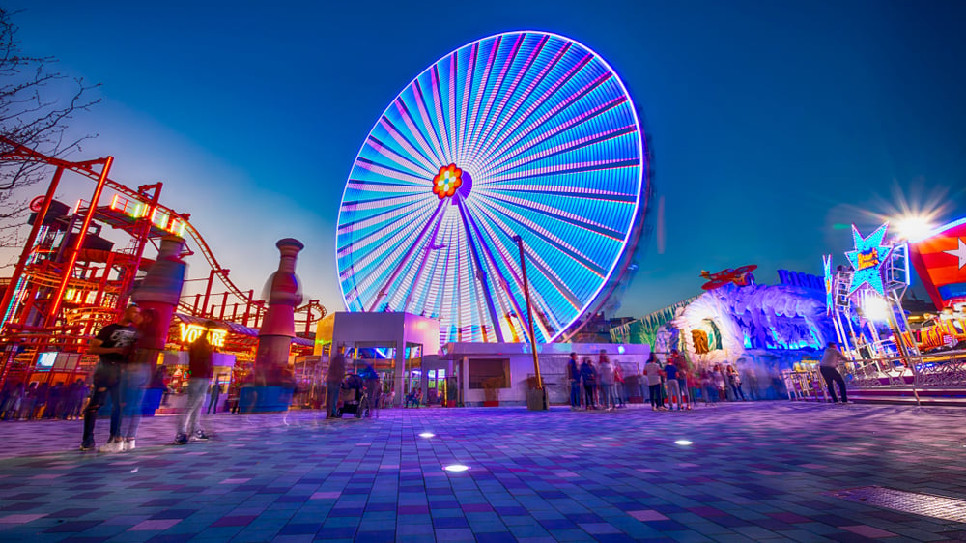
AMUSEMENT PARK TICKETING SYSTEM APP PYTHON PROJECT
SUBMITED BY-
Aditya Kumar (RA2211003010727)
Shalok Gupta (RA2211003010727)
Samarth Agarwal (RA2211003010727)

Slide 2
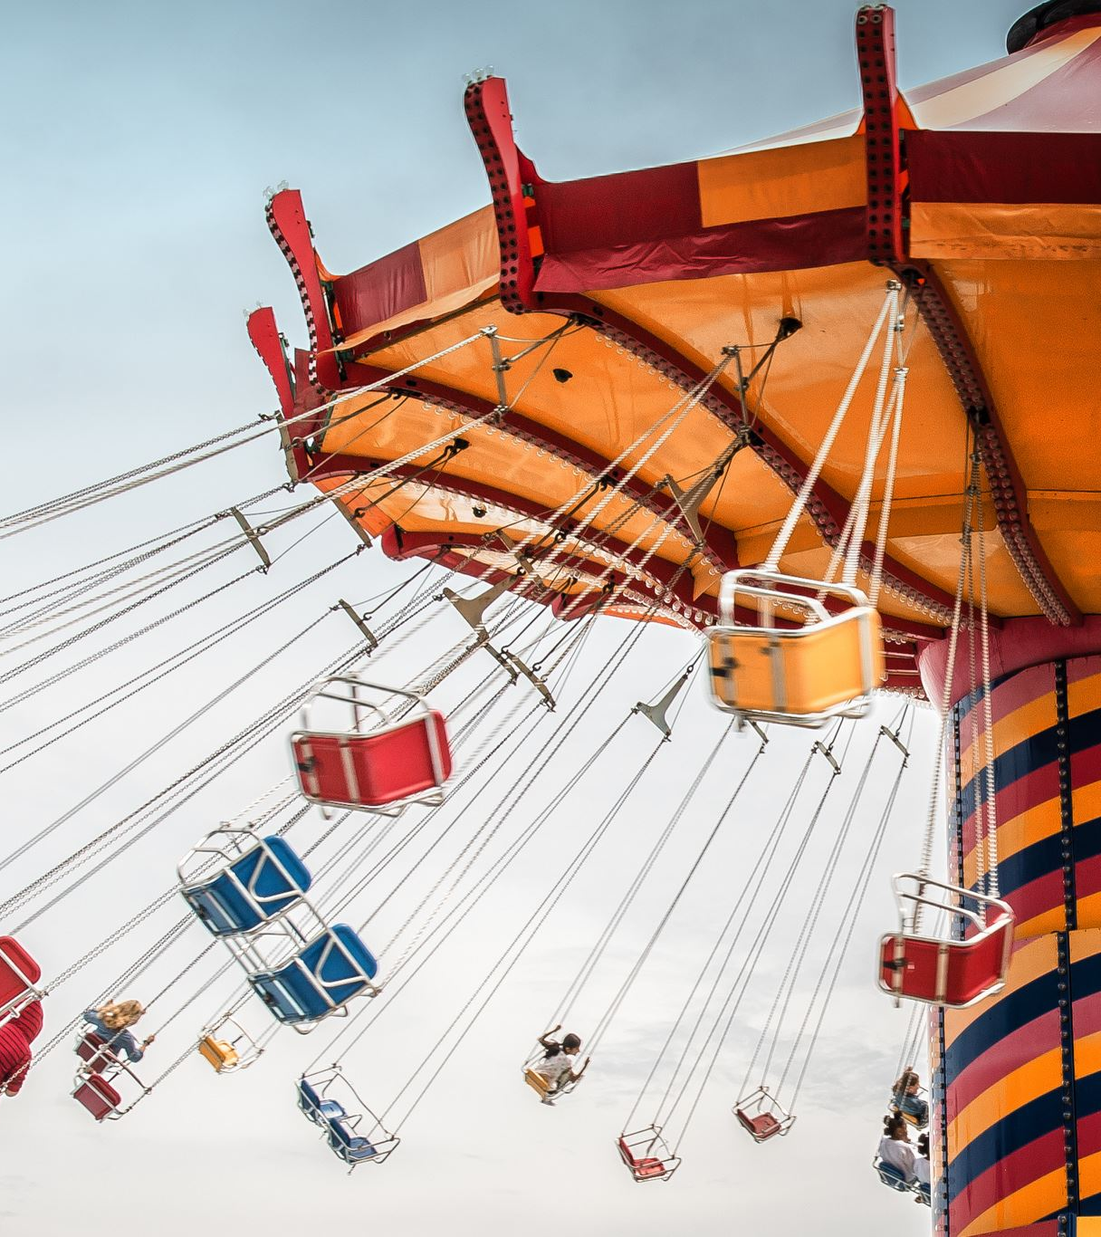
Introduction
Enjoy all rides at our amusement park without the hassle of buying tickets from the counter and getting in long lines with this advanced ticket booking system made specifically to save time and deliver you the VIP experience and also at the same time reduce human contact keeping in mind the 2019 novel coronavirus. Our ticket booking system comes with the option of pre booking rides and also generates the final due amount.
Our program can be used by both the customer and the staff members- The customer can create new bookings for themselves, choose the time slots and view ride and time details and also edit the information they stored whereas the staff having master control can edit time slots as well as the information entered by the user. Via the staff menu a staff member can also clear the database and that is why the staff menu is password protected.

Slide 3
The program creates two tables in the database- First table being the one that stores all the basic information entered by the customer in which after inputting the information, the system generates an unique user id for each person which is later used to edit or change the information stored. After entering the basic information, a customer can choose the rides as well as the time which will be stored in the second table along with the user id so that it can be edited later and also to view the bookings to avoid confusion.
We have created a main menu via which the staff and customer options can be segregated, the staff options will be password protected and the authorized personnel can view or edit any information stored in either tables using the mysql update command. In the customer menu there will be options to create a new booking, edit a previously created booking, view current bookings and retrieve forgotten user ID. The user id will be used as a customer password to edit and view the bookings, however if a person uses the staff menu, they will be given full access and will be allowed to view the customer ID on the basis of the name itself.

Slide 4
AIM
To create an easy to access portal from where by taking input of basic data such as Age, height and prevailing medical issues one can get all the information pertaining to the rides one can enjoy and as well as get their final bill amount. The person can even pre book the food items so as to avoid standing in cues and avoiding unnecessary human contact.
Idea Source
The lines at amusement park counters are often very long.
People don’t usually follow the social distancing norms in cues and this makes long cues a source of covid
19 transfer.
The amusement parks are facing budget issues due to the novel coronavirus.
Many times we see some rides are not working and there's nobody nearby to report
to, or ask for assistance .
People have nowhere to drop or leave their kids or young siblings, so that they can enjoy some
rides themselves.

Slide 5
Plan for implementation
We plan to reduce the waiting lines in the amusement park by facilitating a self booking portal via which the need for human dependency will be reduced. This will also be used to reduce the risk of covid 19 spread. Using the portal, amusement parks will be able to reduce their staff members and save themselves from the budgeting crisis that was created during Covid 19. Not only will all this save customer’s precious time but will also help reduce human contact , thus reducing transmission of covid-19. Booking via eportal will also help amusement park manage their budget and resources which can be further used for maintenance and development of new rides and counters.We have provided with the facility of a kids' room with toys and puzzles so that parents and guardians can also enjoy some rides.
What exactly happens in the program is that we first create a cursor to connect it to the mysql database and then we create the table and mention all the parameters which will act as the first row of the table we are making. Then we create a function which contains a loop which will ask the user to input their name, age, height, phone number, mail, day of visit after which the program will generate an user id which will start from 1000 and then will keep on incrementing as more and more entries are done. We will ask the user after they have input everything if they would like to add more entries for people coming in with their family or friends. Once they have entered the basic information we will ask them the rides they would like to avail and what time slot they would like to avail the ride in. In the second table , the table header consists of time slots and the user is required to fill the ride code of their corresponding choice of ride for each time slot and we have also provided the user with the option of no rides in case the user doesn’t want to do any ride in a timeslot . The user can edit their ride codes in time slots later as well with the help of their user id generated by the system.

Slide 6
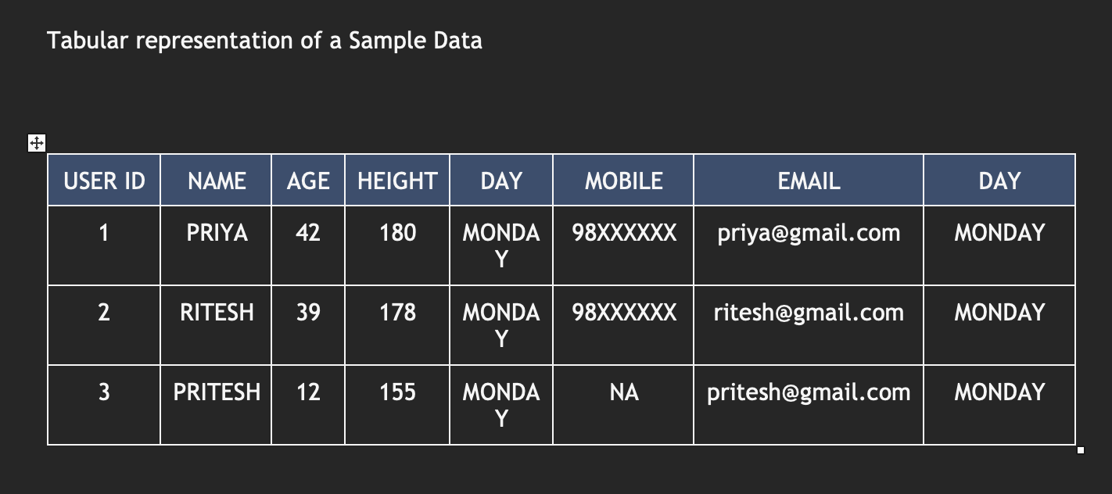
In the next function we will use the select argument to read table 1 and then run a loop to display the contents of the said table. This can be used by both staff and customers to view and then later edit the information of the table.
We will also add a function which when called will give the user the option to edit either the basic information or the rides selected in specific time slots. The user just has to input the table number and then what they would like to edit. Once the user has chosen what they would like to edit the program will update the values.
The staff members will also have the option to clear the data entered in either of the tables without actually deleting the table and they will also have the option to reset the auto_increment.

Slide 7
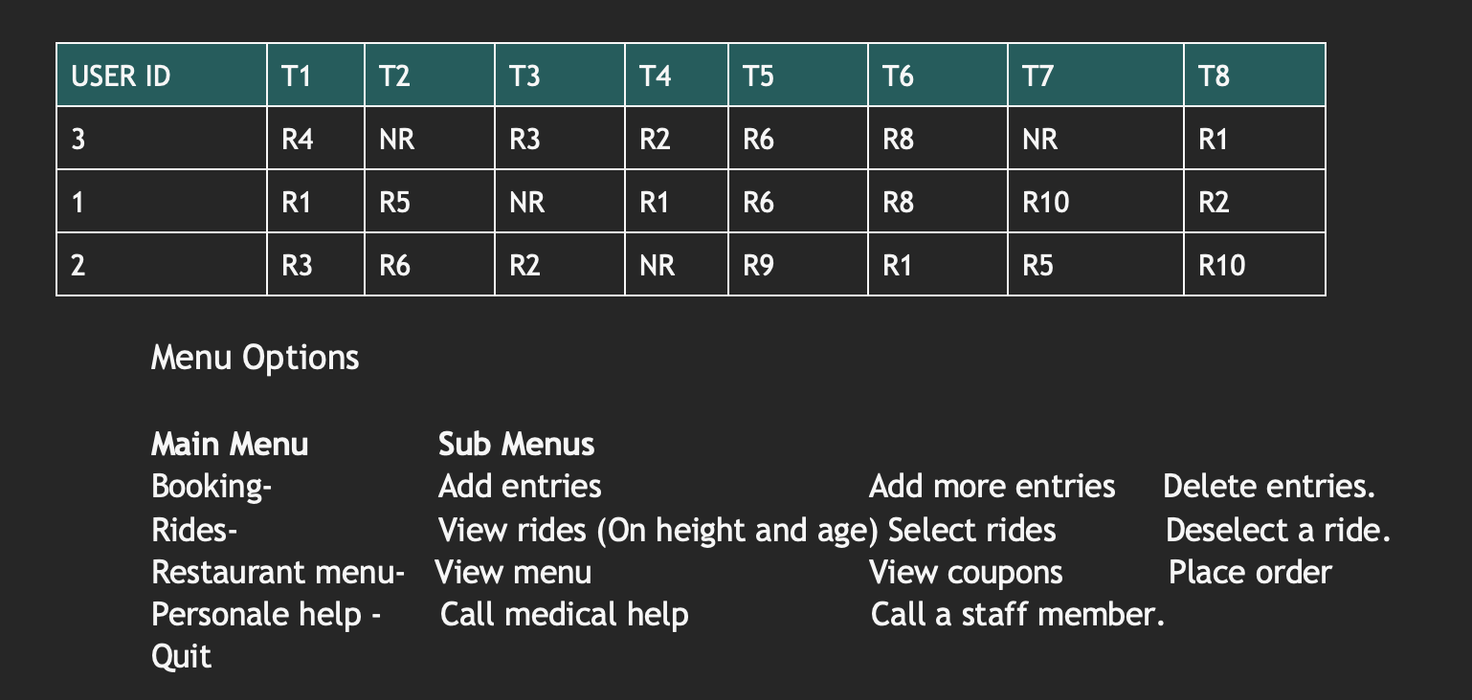

Slide 8
Validations and Add on Features
Verify the number entered
The system also checks if the mail id entered has an ‘@’ sign
Exception handling in all possible cases of wrong entries
Easy to use user interface
Restaurant options
Free coupons with rides
Tells the wait time if the time slots are full
Customer support

Slide 9
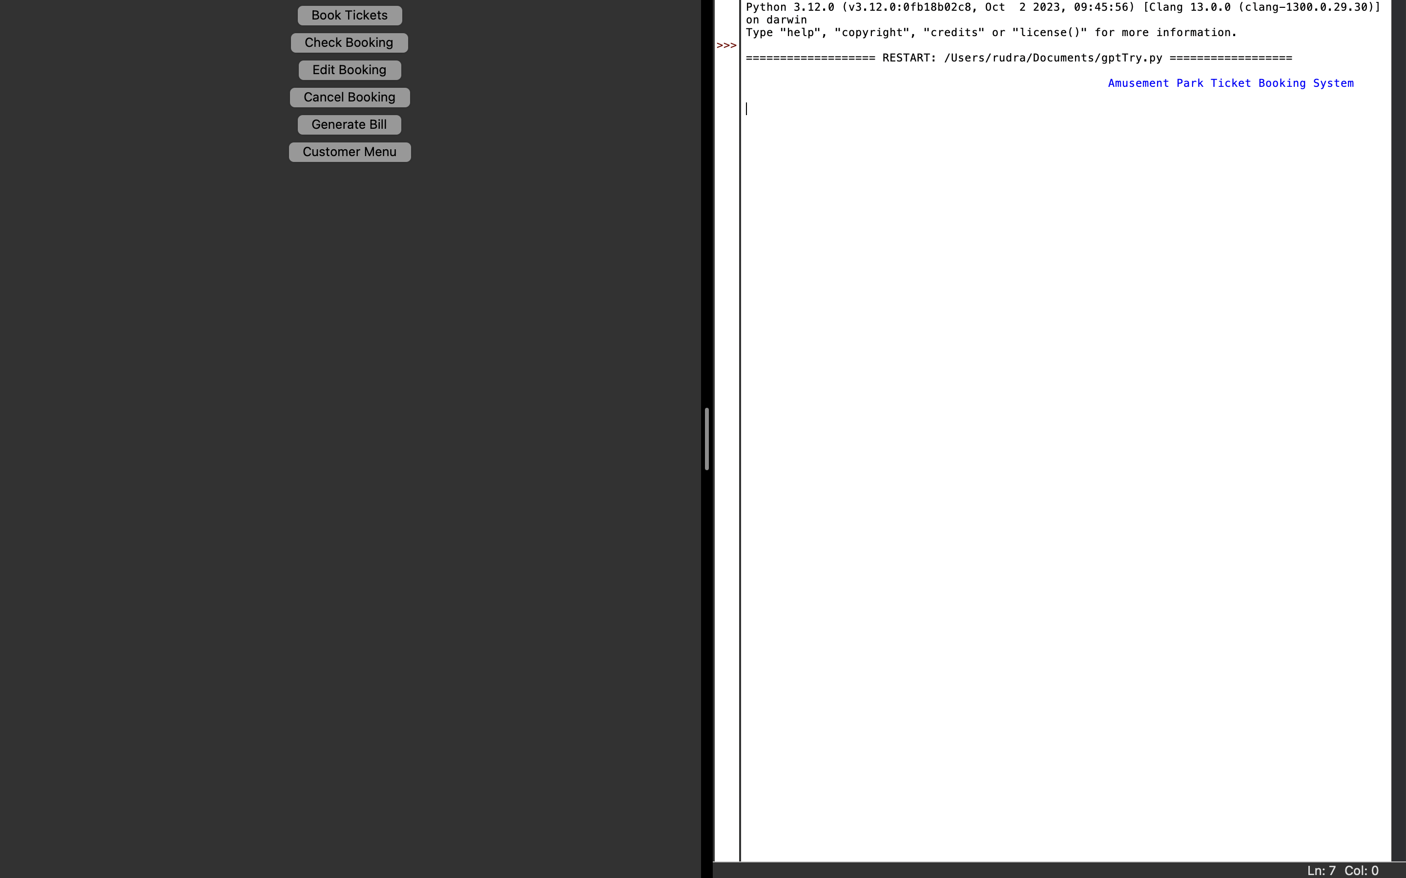

Slide 10
THANK YOU!!

